Slide 1
Electricity and Charge

Slide 2
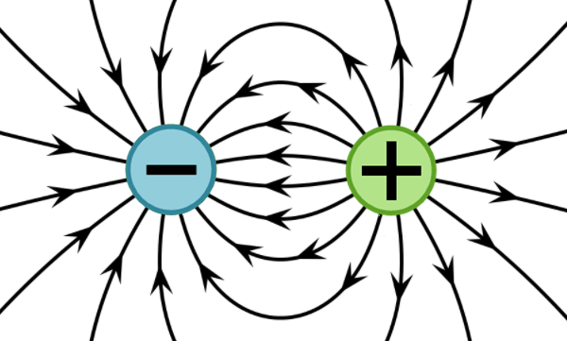
In this Smart Lesson you will learn to:
Understand static electricity.
Recall that electric charge can be positive or negative.
Recall that electric current is carried by discrete electric charge carriers.
Recall the law of conservation of electric charge.

Slide 3
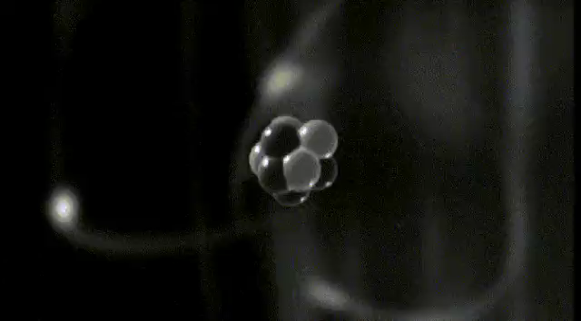
To understand how static electricity works, we need to know about charged particles.
Everything around you is made of atoms. Atoms are made up of three types of particle: protons, electrons and neutrons.

Slide 4
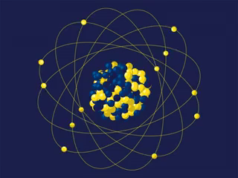
The centre of an atom is called the nucleus.
Protons and neutrons hang out together in the centre (nucleus) of the atom.
Neutrons don't have any charge, but each proton has a positive charge. We represent it with a plus sign.

Slide 5
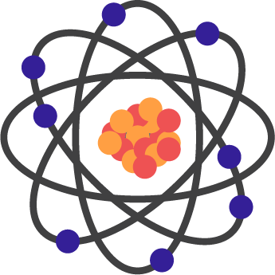
The electrons move in orbits around the outside of the atom.
Electrons are negatively charged. This means they have the opposite charge to protons.
In its normal state, an atom has equal numbers of electrons and protons.

Slide 6
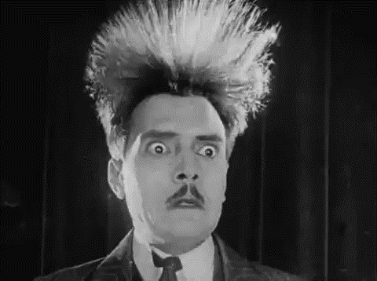
Static electricity is all about charged particles!
Static electricity is created when charged particles build up on an object and give it an overall positive or negative charge.

Slide 7
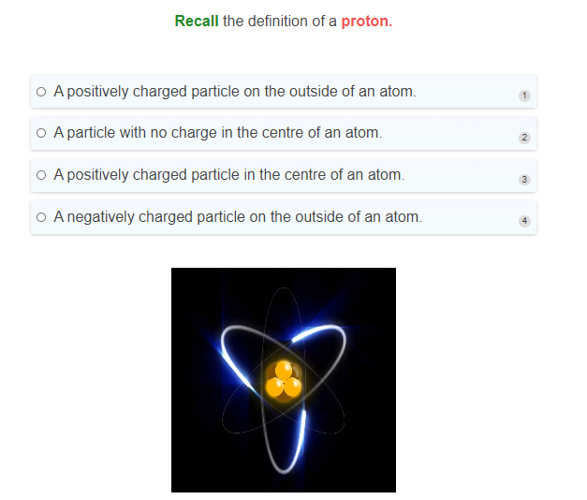

Slide 8
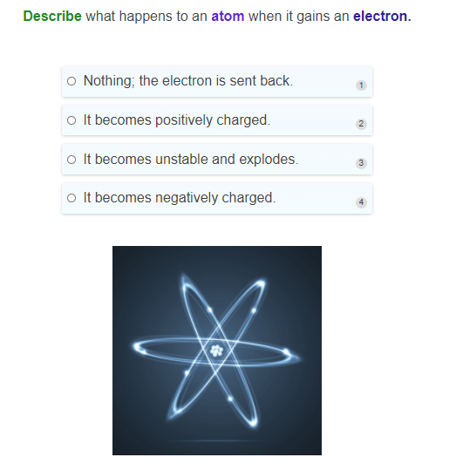

Slide 9
Have you ever touched the car door and felt a small shock?
This is caused by static electricity!
Electrostatic force is the force between two electrically charged objects. It is behind the awesomeness of static electricity!

Slide 10
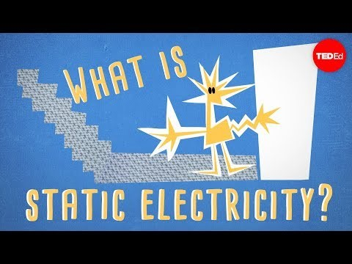

Slide 11
Static electricity builds up when objects become either negatively or positively charged.
Opposite charges attract each other through the electrostatic force!
For instance, when you rub a balloon against your hair, it becomes negatively charged and will stick to your hair, which is now positively charged! Electrons have moved from your hair to the balloon.

Slide 12
Remember, objects become charged by either gaining or losing electrons.
Objects with the same charge repel each other through the electrostatic force.
Two positively charged objects will push each other apart.

Slide 13
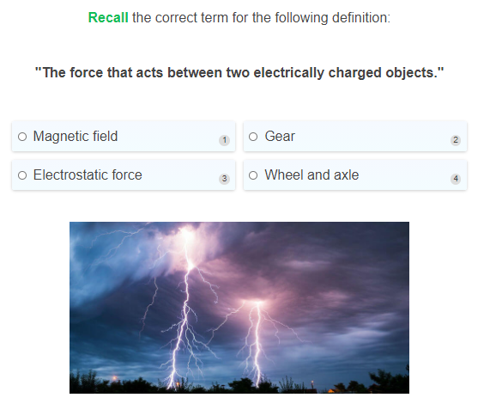

Slide 14
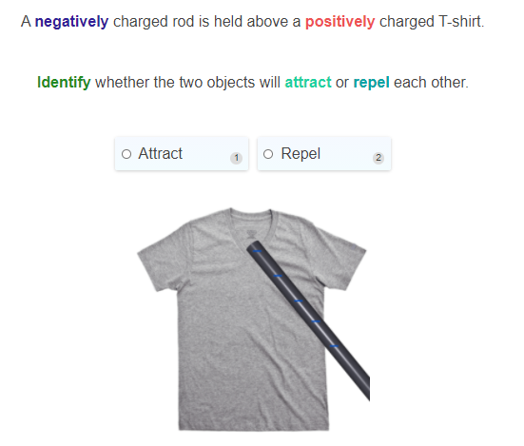

Slide 15
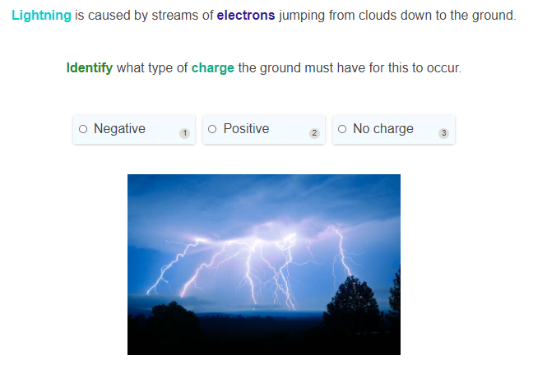

Slide 16
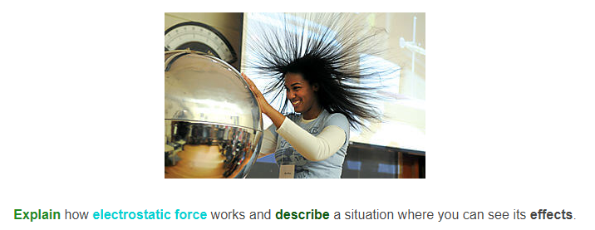

Slide 17
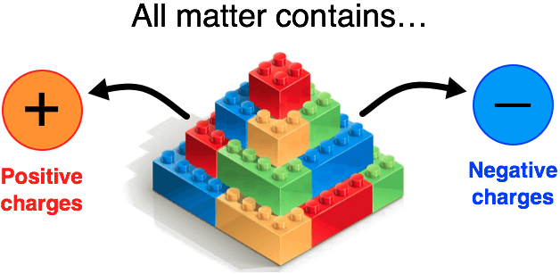
Electric charge.
Electric charge is defined as a physical property of an object that causes it to experience a force when placed in an electromagnetic field.
Electric charge can be either positive or negative.

Slide 18
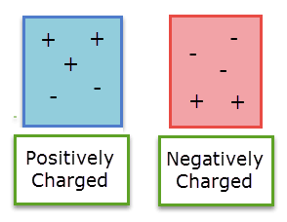
Objects are made up of positive and negative charges, which at the particle level are respectively protons and electrons.
A neutral object has a charge value of zero, as it has an equal number of positive and negative charges.
If an object has more positive charges than negative charges, it is positive. If it has more negative charges than positive charges, it is negative.

Slide 19
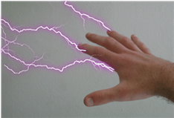
Electrical energy is a form of energy that is easy to create and transfer to make new forms of energy.
It is the energy of electricity, which powers our world.
This energy is created by movement of charge. Protons do not move easily since they are trapped in the nucleus, so electron movement creates electricity.
The electrons must be unbound from their atoms to move, so systems with many delocalised electrons tend to be good conductors of electricity. Metals are an example of a good conductor, because their electrons are relatively free to move around.

Slide 20
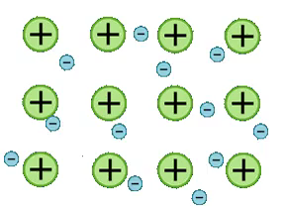
Electrical current definition.
Electrical current is defined as the rate of movement of electric charge carriers from one part of a conductor to another.
The most common charge carriers are electrons and ions.
For example, the charge carriers in an ionic solution (electrolyte) are ions.
The charge carriers in a metal are the delocalised electrons.

Slide 21
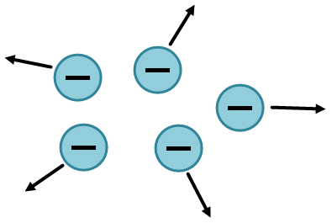
Charged particles can interact by attracting or repelling one another.

Slide 22
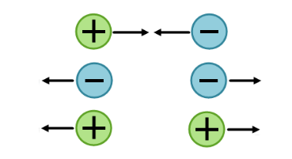
When do charges attract and when do they repel each other?
Opposite charges will attract one another.
Like charges will repel one another.

Slide 23

Neutral objects such as neutrons do not interact with charged particles.
They will neither be repelled nor attracted by another charge.

Slide 24
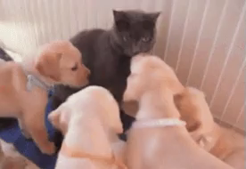
The attraction and repulsion of charges is an extremely important concept.
So make sure you remember: Opposites attract!

Slide 25
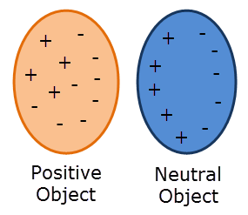
The charge of an object can be changed by moving electrons around.
For example, rubbing a balloon on your hair moves electrons from the balloon to your hair. This gives you a negative charge and the balloon a positive one.
The positively charged balloon can then attract a neutral piece of paper by attracting the individual charges inside the paper. This displaces electrons towards the balloon, leaving the negative charge on one side, and the positive charge on the other.

Slide 26
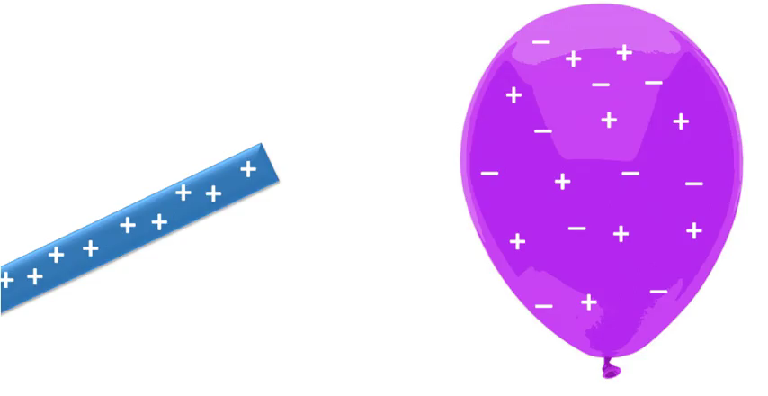
Law of conservation of electric charge.
The law of conservation of electric charge states that the total electric charge of an isolated system remains constant regardless of changes within the system.
For example, if you brought up a positively charged rod towards an uncharged balloon, the electrons in the balloon will be attracted towards the rod. However, the total electric charge on the balloon will remain neutral (same number of positives and negatives) as there has been no transfer of electrons between the balloon and the surroundings. There has simply been a redistribution of charge.

Slide 27
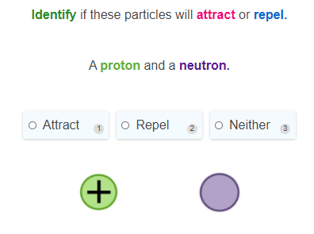

Slide 28
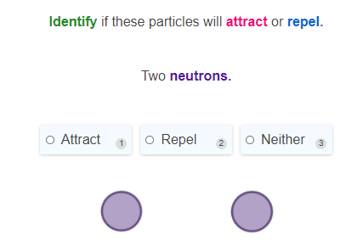

Slide 29
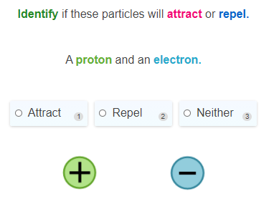

Slide 30
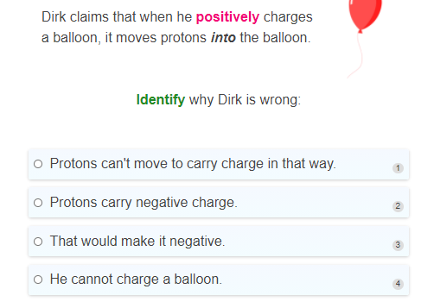

Slide 31
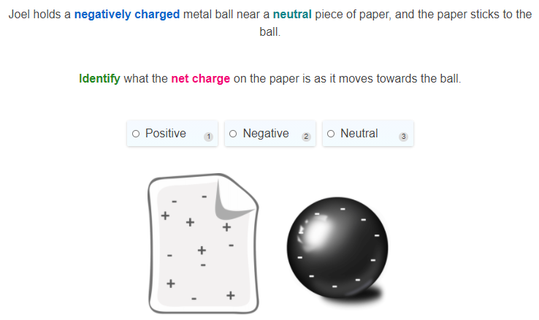

Slide 32
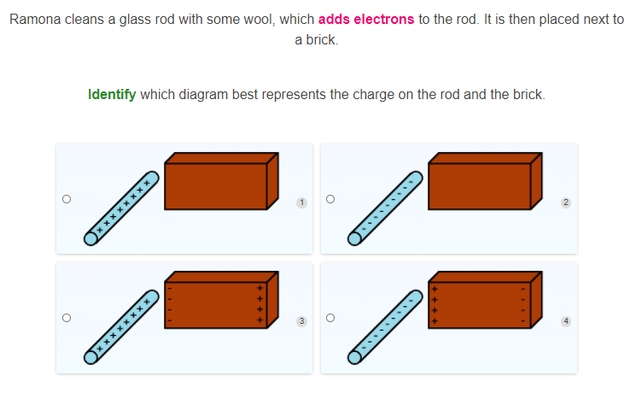

Slide 33
